Slide 1

Trusted AI – Aviation Final Project Results Saurav Subash Prasad ,Vishwas Shivakumar, Akhilesh Gowda Mandya Ramesh, Sai Surya Pulagam , Anirudh Emani
ENGR-E 583 – Information Visualization
INDIANA UNIVERSITY BLOOMINGTON

Slide 2
Background
Communication between pilots and air traffic controllers (ATC) is among the aviation industry's top safety issues. Serious accidents might result from poor or inadequate communication.
Aviation safety can be seriously threatened by severe weather conditions like turbulence, icing, thunderstorms, and other natural occurrences. For safe flying operations, accurate weather predictions and emergency preparedness are necessary.
Maintenance performed by airlines is essential to the safe operating of aircraft. Particularly in poorer nations, questions have been raised about the sufficiency and efficiency of aviation maintenance systems.
Pilot fatigue is a serious problem that can impair a pilot's ability to make wise decisions, raising the possibility of an accident. Pilot weariness may be brought on by lengthy workdays, erratic scheduling, and time zone changes.

Slide 3
Insight Needs
Primary – Correlations & Relationships What is the correlation between various cause factors? What are the possible effects of various cause factor codes/types?
Additional – Trends How has the civil aviation industry come to change over the years? What type of incidents/maintenance problems are more common now?

Slide 4
Data Analysis
We used the FAA's AIDS (Accident and Incident Data System).
The dataset captures all air accidents and incidents since 1975.
We focused extensively on cause factors (in the "a" files) and NTSB investigation remarks (in the "e" files) and attempt to draw a knowledge graph that shows the cause-and-effect relationship between various root causes and the resulting incidents.
We also focused on fatalities, geolocations, weather conditions and additional contributing factors.
We considered several other parameters available in the dataset to understand how anthropological factors such as the average age of pilots may have contributed to incidents. We also analyzed the geographic distribution of accidents and how the regions with the most incidents have come to change.

Slide 5
Visualizations
Knowledge Graph – To show the cause-and-effect relationship between the five most common primary cause factors and the type of incidents, along with contributing factors.
Tableau Dashboard (geomaps, histograms, bar and line charts) – To see which areas are more prone to accidents now and if this has changed over the years, and other metrics such as pilot age, aircraft age, etc.
Word Trees – Using NLP and clustering algorithms to try and identify additional factors that may have impacted air safety.

Slide 6
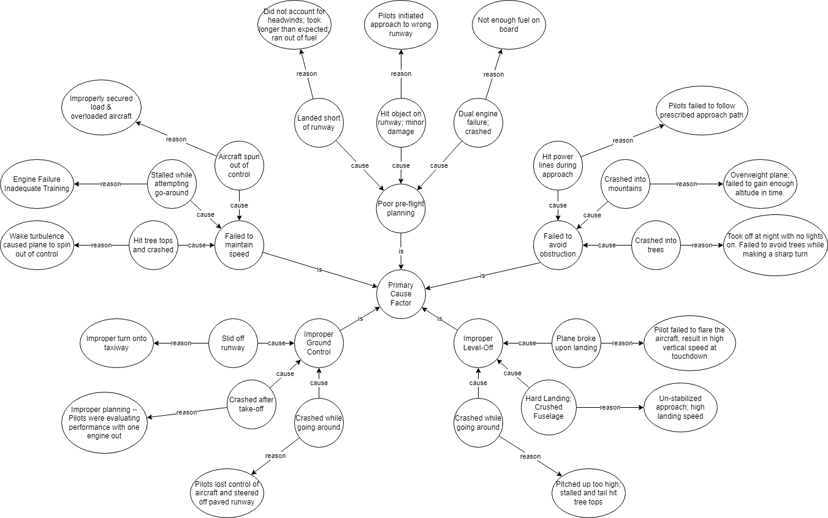
Five most common cause factors
This knowledge graph shows categories of air incidents by their primary cause factors. Moving outward in the graph, we can see an example for each, along with contributing factors.

Slide 7
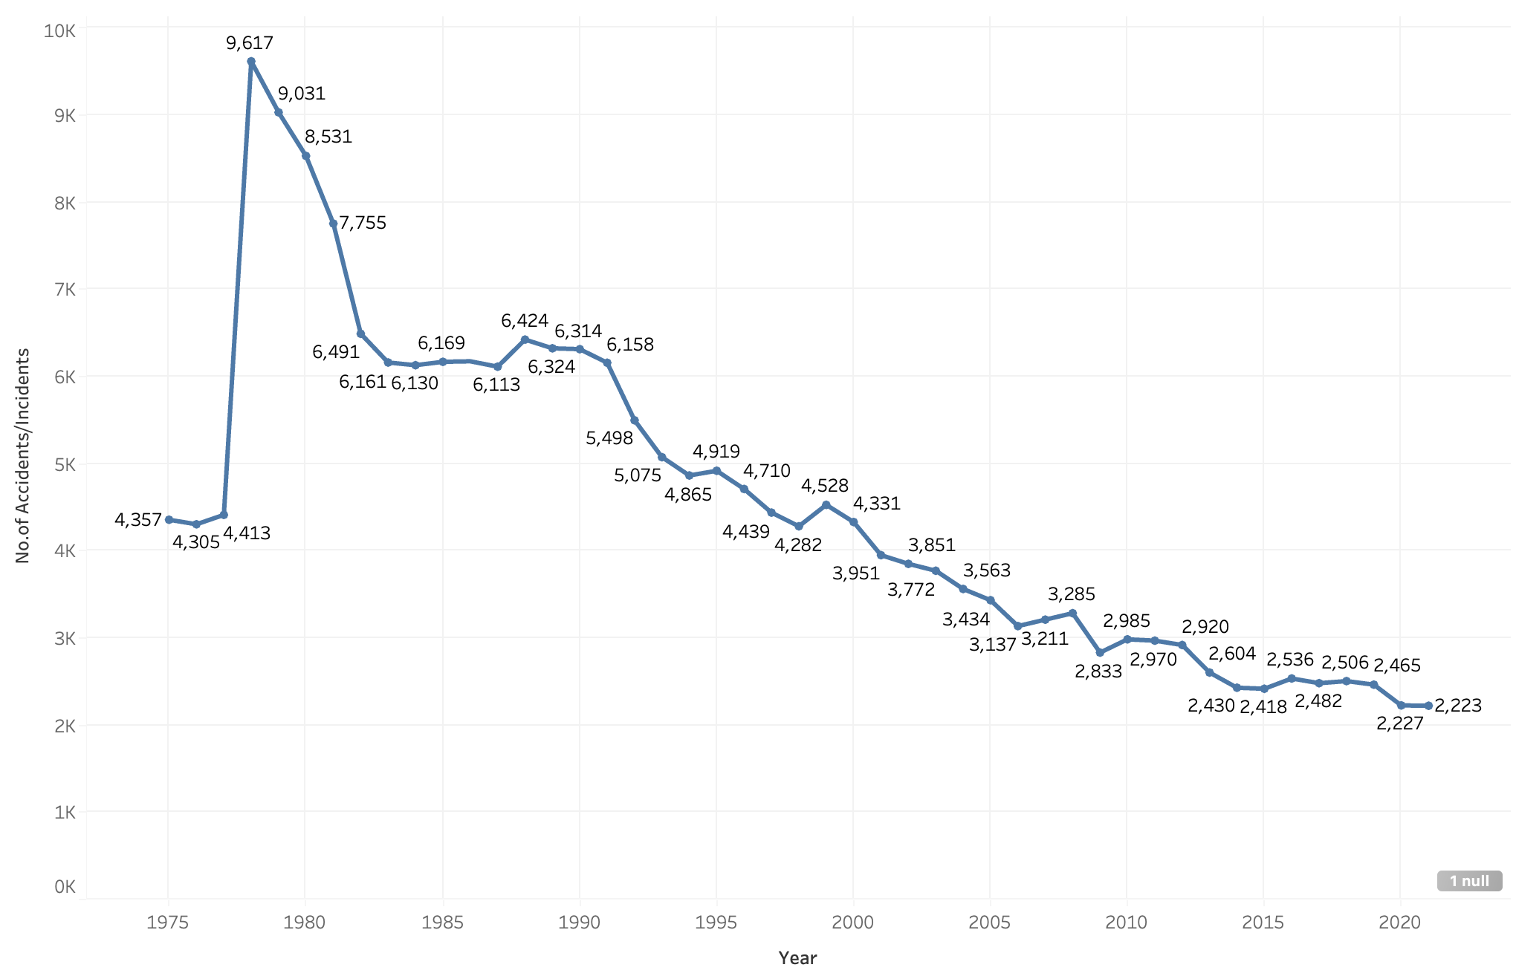
Trends
While looking at the data we found that there is a huge jump in the number of accidents between 1977 and 1978. On further investigation we found that this was due to FAA Establishment of the Aviation Safety Reporting System (ASRS) , Introduction of the Terminal Radar Service Area (TRSA) and also the FAA's regulatory authority was expanded to include oversight of aviation safety, aircraft design, and manufacturing.
Between 1988 and 1998 we can see that the number of accidents reduced by 33% this due to the additional safety measure taken such as , Implementation of the Advanced Automation System (AAS),introduction of the Wide Area Augmentation System (WAAS), Adoption of Safety Management Systems (SMS) and Development of the Global Positioning System (GPS).
Between 1998 and 2021, the Federal Aviation Administration (FAA) achieved several milestones and undertook numerous initiatives to improve safety, efficiency, and modernization in the aviation industry. Here are some of the key achievements ,Implementation of the Automatic Dependent Surveillance-Broadcast (ADS-B) system, Establishment of the Aviation Safety Information Analysis and Sharing (ASIAS) system , Introduction of the Runway Safety Program.

Slide 8
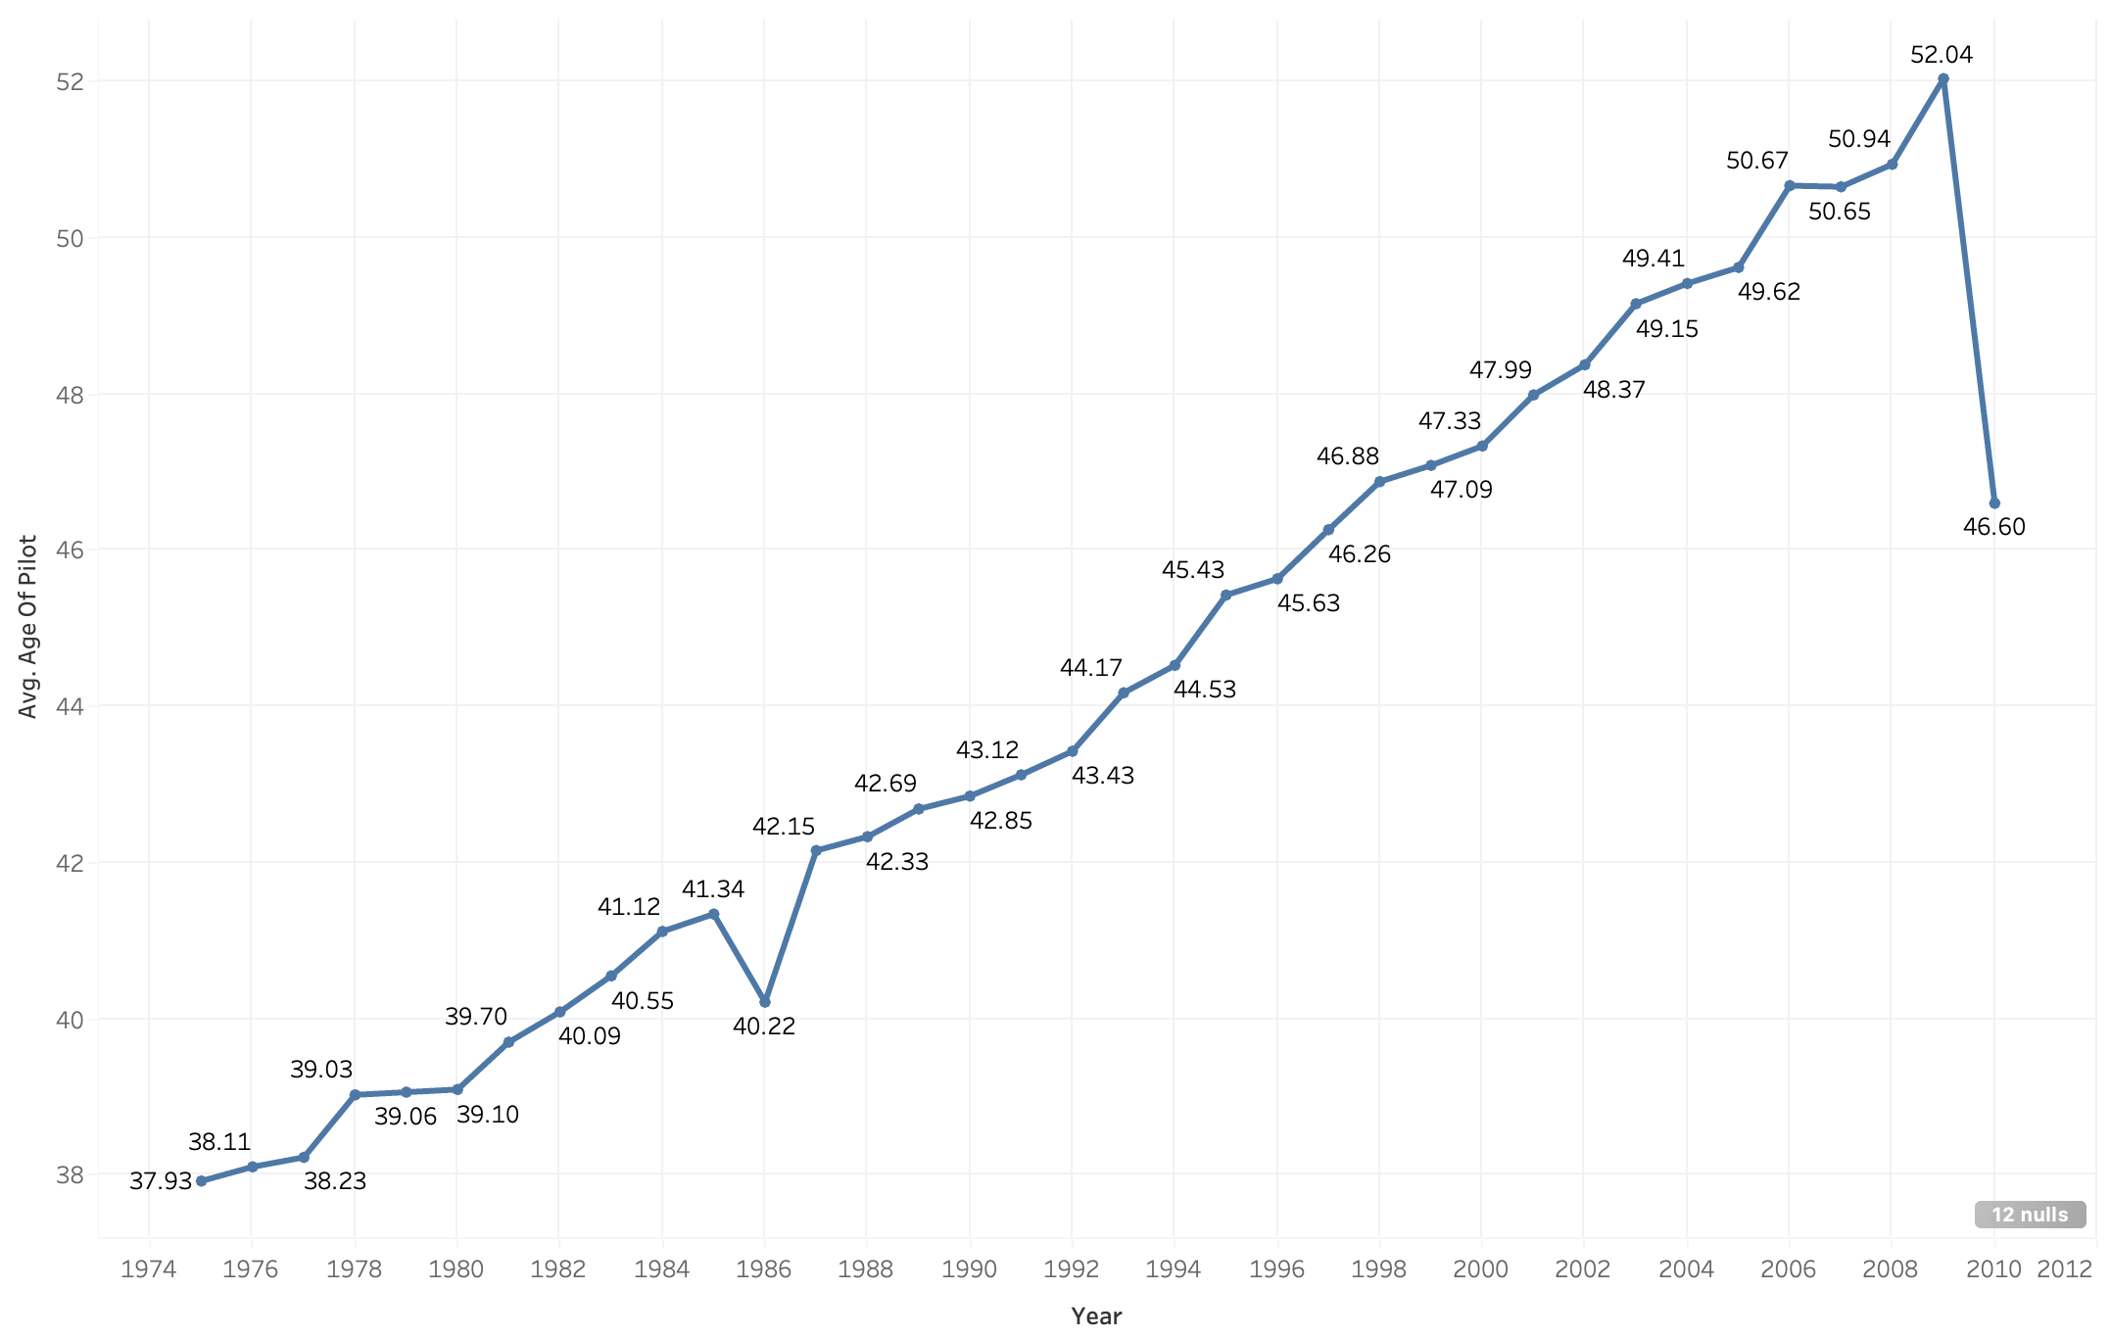
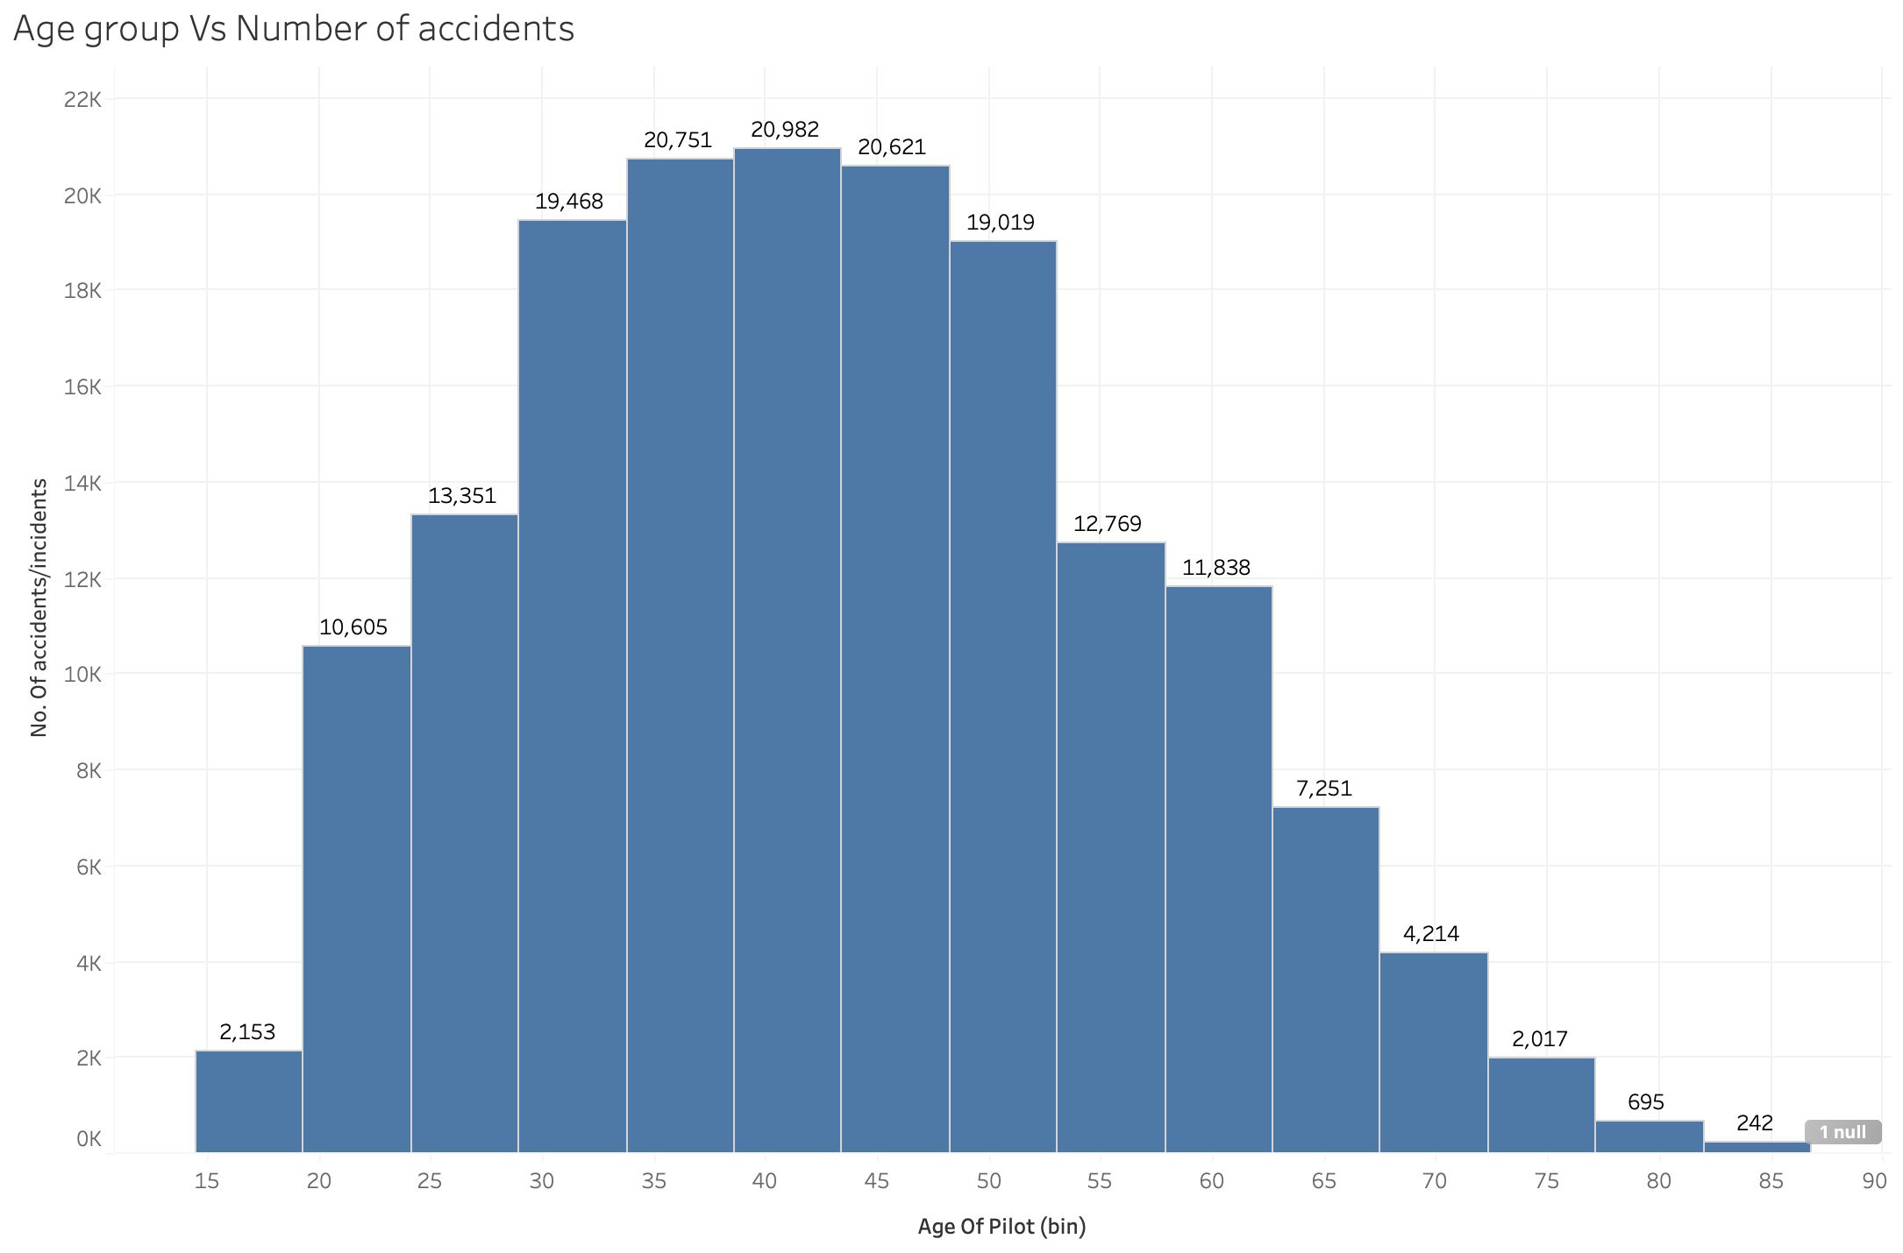
Trends
We also noticed that the Avg Age of Pilots has increased over the years we wanted to see why this is the case and how has it helped for Aviation Safety. These are some of the findings.
Regulatory changes: The Federal Aviation Administration (FAA) raised the mandatory retirement age of commercial airline pilots from 60 to 65 in 2007, allowing experienced pilots to continue flying for longer.
Economic factors: Improved working conditions and higher pay and benefits have encouraged many experienced pilots to continue working rather than retiring early.
Demographic shifts: As the overall population ages, the number of younger pilots entering the industry has decreased, leading to a shortage of pilots and further increasing the demand for experienced pilots.
In the first plot we can see there is a sudden dip in avg age of pilots in 2012 this is because after 2010 FAA slowly started to omit some columns and does not record those data anymore. But with the available data we can see the histogram of avg age of pilots vs no. Of accidents/incidents each bin of age groups have had over the years.

Slide 9
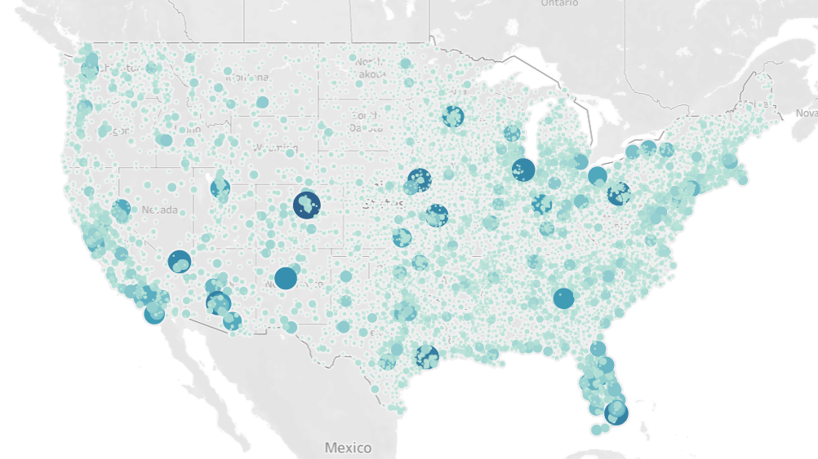
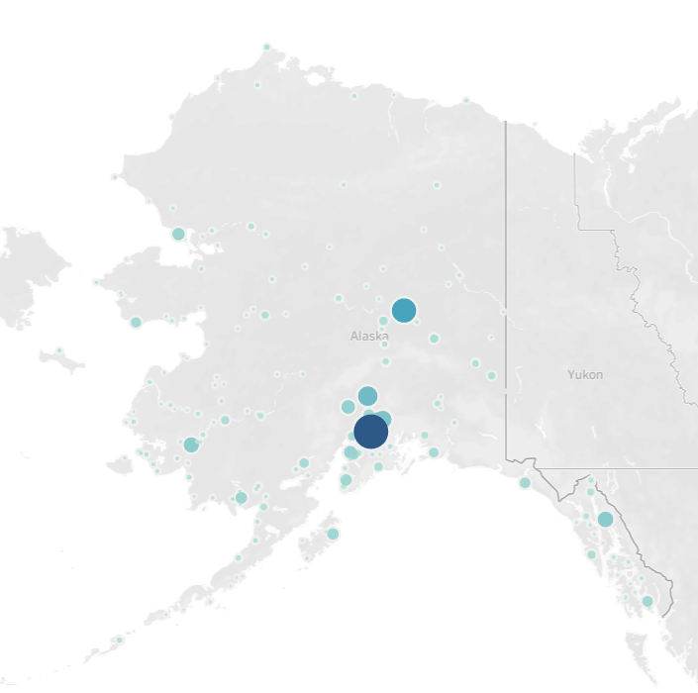

Map Visualization
Higher accident numbers around major US airports – O'Hare, Hartsfield-Jackson, Phoenix Sky Harbour, Denver, LAX, Houston-Bush, Miami, etc.
More accidents per capita in Alaska due to significantly worse weather conditions.
Texas, California, and Florida have tens of thousands of private aircraft, and therefore have more distributed, and a larger number of incidents.

Slide 10
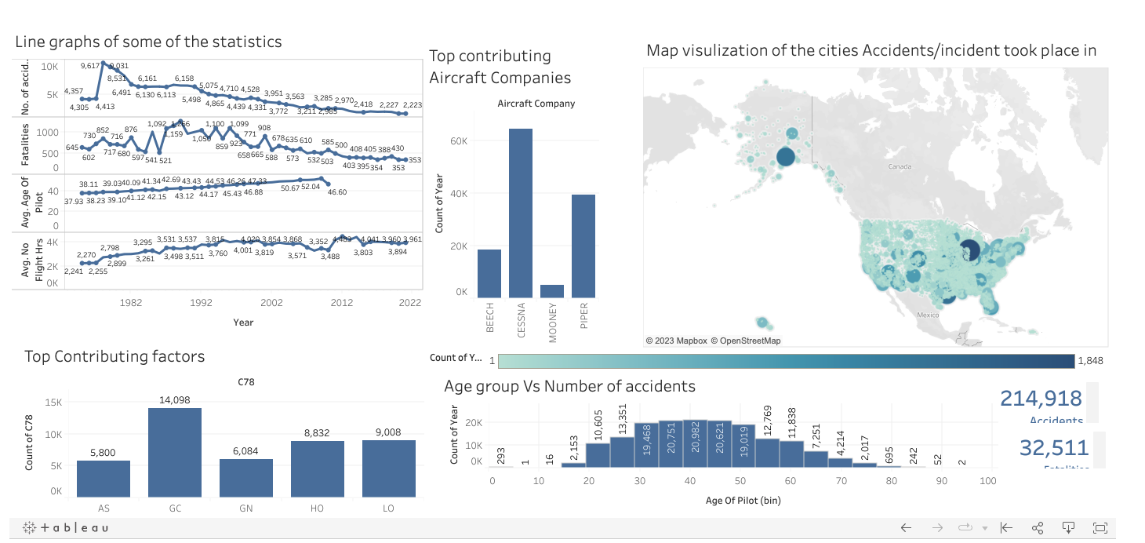
Tableau Dashboard
The tableau dashboard on the right shows all the necessary information regarding the Accidents and incidents that occurred.
Having this broad overview is helpful especially when we want to see the cause-and-effect relation between different factors.
This interactive dashboard changes all the visualization when any data point is selected.
Link for the dashboard:- https://public.tableau.com/app/profile/vishwas.shivakumar/viz/FAA2_16804727284240/Dashboard1?publish=yes

Slide 11
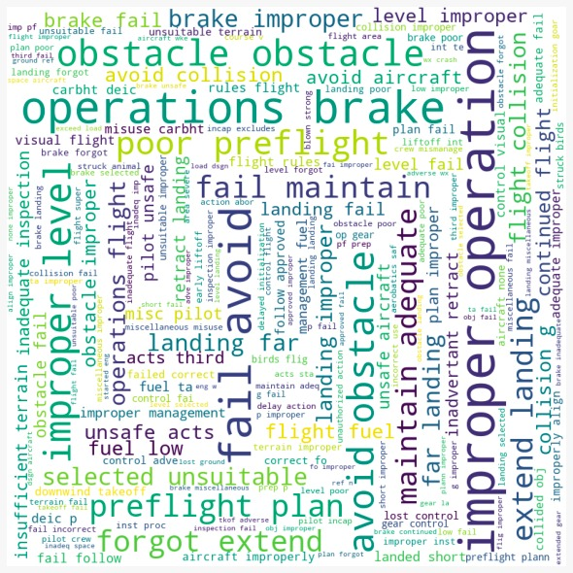
Word Tree
On the right we have a word cloud showing the most common words from the remarks received on the Accident/Incident.
The most common causes of crashes in the FAA's data were the inability to avoid obstacles, improper landings, brake failures, parts failing, forgetting to extend the landing gear, failure to maintain proper height, and poor pre-flight checking. These insights provide valuable information on the key factors contributing to aviation accidents and incidents

Slide 12
Acknowledgements
We express our gratitude to Lindsey Miche for granting us access to the data set and serving as a valuable stakeholder throughout the project.
Our sincere thanks go to Dr. Andreas Bueckle and Dr. Katy Börner for affording us the privilege to collaborate on this project as part of the E583 Information Visualization course.

Slide 13
Thank you!

